Slide 1
Chapter 5
Stacks

Slide 2
Chapter Objectives
To learn about the stack data type and how to use its four functions:
push
pop
top
empty
To understand how C++ implements a stack
To learn how to implement a stack using an underlying array or linked list
To see how to use a stack to perform various applications, including finding palindromes, testing for balanced (properly nested) parentheses, and evaluating arithmetic expressions

Slide 3
Stacks are Specialized Lists
A client using a list can access any element, remove any element, and insert an element anywhere in the list
A client using a stack can access (and remove) only the most recently inserted element, and can insert an element only at the “top” of the stack
Stacks are among the most commonly used data structures in computer science

Slide 4
The Stack Abstract Data Type
Section 5.1

Slide 5
Stack Abstract Data Type
A stack is one of the most commonly used data structures in computer science
A stack can be compared to a Pez dispenser
Only the top item can be accessed
You can extract only one item at a time
The top element in the stack is the last added to the stack (most recently)
The stack’s storage policy is Last-In, First-Out, or LIFO

Slide 6
Specification of the Stack Abstract Data Type
Only the top element of a stack is visible; therefore the number of operations performed by a stack are few
We need the ability to
test for an empty stack (empty)
retrieve the top element (top)
remove the top element (pop)
put a new element on the stack (push)

Slide 7
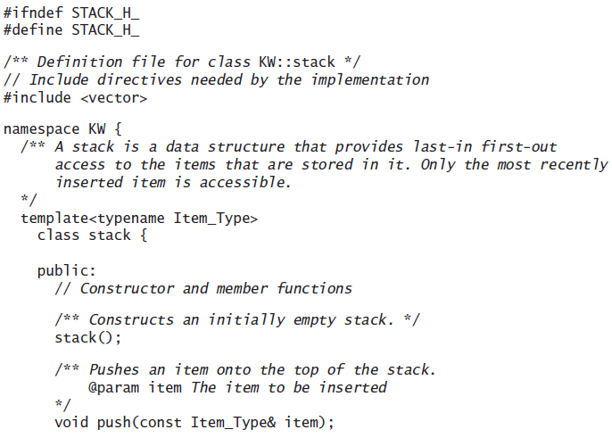
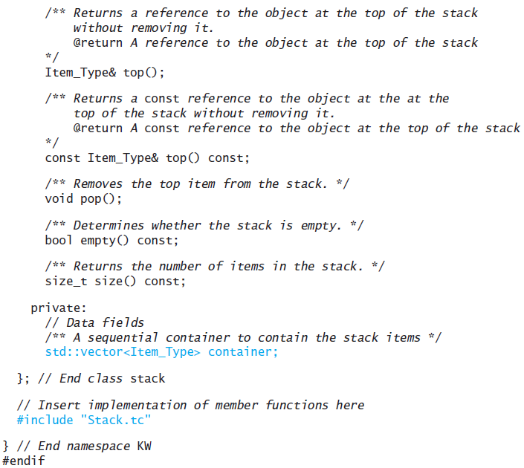
Specification of the Stack Abstract Data Type (cont.)

Slide 8
A Stack of Strings
We create the (a) stack using the following statements:
stack<string> names;
names.push("Rich");
names.push("Debbie");
names.push("Robin");
names.push("Dustin");
names.push("Jonathan");

Slide 9
A Stack of Strings (cont.)
For stack names in (a), the value of names.empty() is false
The statement
string last = names.top();
stores "Jonathan" in last without changing names
The statement
names.pop()
removes "Jonathan" from names
The stack names now contains four elements as shown in (b)

Slide 10
A Stack of Strings (cont.)
The statement
names.push("Philip");
pushes "Philip" onto the stack
The stack names now contains five elements and is shown in (c)

Slide 11
Stack Applications
Section 5.2

Slide 12
Finding Palindromes
Palindrome: a string that reads identically in either direction, letter by letter (ignoring case)
kayak
"I saw I was I"
“Able was I ere I saw Elba”
"Level madam level"
Problem: Write a program that reads a string and determines whether it is a palindrome

Slide 13
Finding Palindromes (cont.)
Analysis:
Possible solutions:
Set up a loop in which we compare the characters at each end of a string as we work towards the middle
If any pair of characters is different, the string can’t be a palindrome
Scan a string backward (from right to left) and append each character to the end of a new string, which would become the reverse of the original string. Then we can determine see if the strings were equal
The approach we will take here uses a stack to assist in forming the reverse of a string
It is not the most efficient way to solve the problem, but it makes good use of a stack

Slide 14
Finding Palindromes (cont.)
Analysis:
If we scan the input string from left to right and push each character in the input string onto a stack of characters, we can form the reverse of the string by popping the characters and joining them together in the order that they come off the stack
For example, the stack at left contains the characters in the string "I saw"
If we pop them off and join them together, we get "w" + "a" + "s" + " " + "I", or the string "was I"
When the stack is empty, we can compare the string we formed with the original
If they are the same, the original string is a palindrome
w
a
s
I

Slide 15
Data Requirements
PROBLEM INPUTS
An input string to be tested
PROBLEM OUTPUTS
A message indicating whether the string is a palindrome

Slide 16
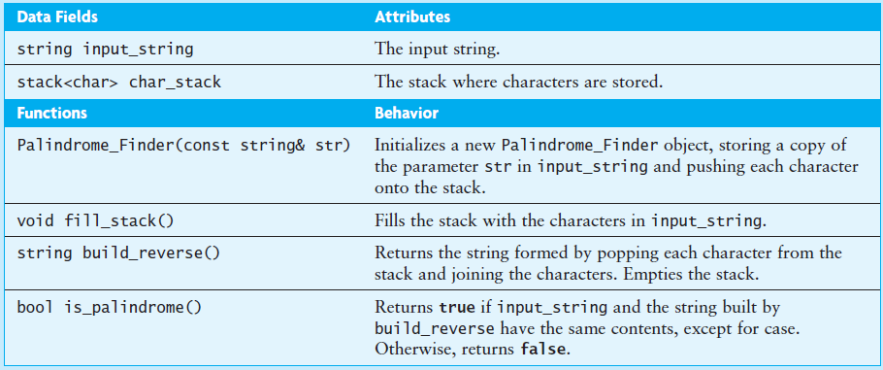
Design

Slide 17
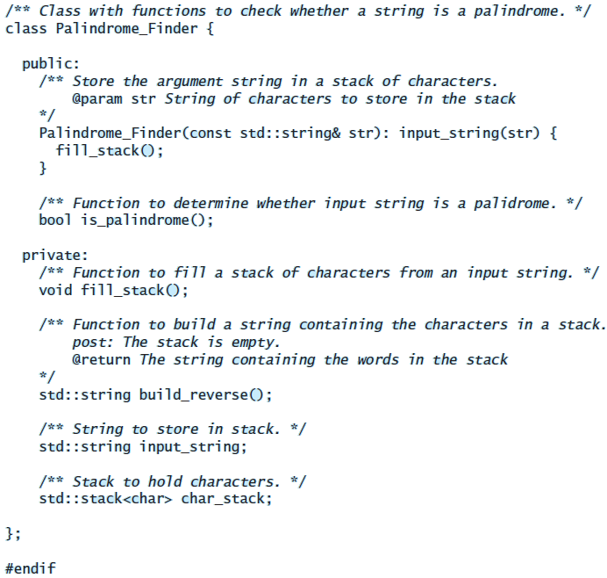
Implementation

Slide 18
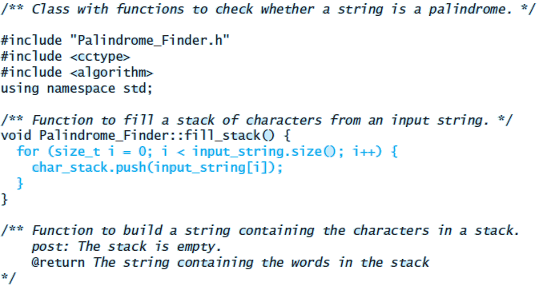
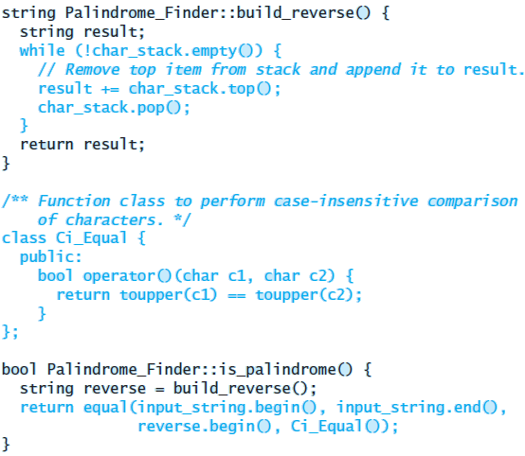
Implementation (cont.)

Slide 19
Testing
To test this class using the following inputs:
A single character (always a palindrome)
Multiple characters in one word
Multiple words
Different cases
Even-length strings
Odd-length strings
An empty string (considered a palindrome)

Slide 20
Testing (cont.)
An application of class Palindrome_Finder should have the following main function:
int main() {
string line;
cout << "Enter a string followed by a new line\n"
<< "To quit, enter an empty line: ";
while (getline(cin, line) && (line != "")) {
cout << line;
if (Palindrome_Finder(line).is_palindrome())
cout << " is a palindrome\n\n";
else
cout << " is not a palindrome\n\n";
cout << "Enter a new string to test: ";
}
if (line == "")
cout << “The empty string is a palindrome\n\n";
}

Slide 21
Balanced Parentheses
When analyzing arithmetic expressions, it is important to determine if an expression is balanced with respect to parentheses
The expression below is balanced:
(w * (x + y) / z – (p / (r - q)))
The problem is complicated if braces or brackets are used in conjunction with parentheses
The expression below is not balanced:
(w * [x + y) / z – [p / {r – q}])

Slide 22
Analysis
An expression is balanced if each subexpression that starts with the symbol “{“ ends with the symbol “}”, and the same statement is true for the other symbol pairs
Another way of saying this is that an opening parenthesis at position k in the sequence “{[(“ must be paired with the closing parenthesis at position k in the sequence “}])”

Slide 23
Analysis (cont.)
We can use a stack to determine whether the parentheses are balanced (or nested properly):
We will scan the expression from left to right, ignoring all characters except for parentheses
We will push each open parenthesis onto a stack of characters
When we reach a closing parenthesis, we will see whether it matches the open parenthesis symbol on the top of the stack
If so, we will pop it off and continue the scan
If the characters don’t match or the stack is empty, there is an error in the expression
If there are any characters left on the stack when we are finished, that also indicates an error

Slide 24
Data Requirements
PROBLEM INPUTS
An expression string
PROBLEM OUTPUTS
A message indicating whether the expression has balanced parentheses

Slide 25
Design

Slide 26
Balanced Parentheses (cont.)
Expression:
(w * [x + y] / z)
0
1
2
3
4
5
6
7
8
9
10
(
(
(
w
*
[
x
+
y
]
/
z
)
balanced : true
index : 0

Slide 27
Balanced Parentheses (cont.)
Expression:
(w * [x + y] / z)
0
1
2
3
4
5
6
7
8
9
10
(
(
(
w
*
[
x
+
y
]
/
z
)
balanced : true
index : 1

Slide 28
Balanced Parentheses (cont.)
Expression:
(w * [x + y] / z)
0
1
2
3
4
5
6
7
8
9
10
(
(
(
w
*
[
x
+
y
]
/
z
)
balanced : true
index : 2

Slide 29
Balanced Parentheses (cont.)
Expression:
(w * [x + y] / z)
0
1
2
3
4
5
6
7
8
9
10
[
[
(
(
(
w
*
[
x
+
y
]
/
z
)
(
balanced : true
index : 3

Slide 30
Balanced Parentheses (cont.)
Expression:
(w * [x + y] / z)
0
1
2
3
4
5
6
7
8
9
10
[
(
(
w
*
[
x
+
y
]
/
z
)
(
balanced : true
index : 4

Slide 31
Balanced Parentheses (cont.)
Expression:
(w * [x + y] / z)
0
1
2
3
4
5
6
7
8
9
10
[
(
(
w
*
[
x
+
y
]
/
z
)
(
balanced : true
index : 5

Slide 32
Balanced Parentheses (cont.)
Expression:
(w * [x + y] / z)
0
1
2
3
4
5
6
7
8
9
10
[
(
(
w
*
[
x
+
y
]
/
z
)
(
balanced : true
index : 6

Slide 33
Balanced Parentheses (cont.)
Expression:
(w * [x + y] / z)
0
1
2
3
4
5
6
7
8
9
10
[
(
(
(
w
*
[
x
+
y
]
/
z
)
(
Matches! Balanced still true
balanced : true
index : 7

Slide 34
Balanced Parentheses (cont.)
Expression:
(w * [x + y] / z)
0
1
2
3
4
5
6
7
8
9
10
(
(
(
w
*
[
x
+
y
]
/
z
)
balanced : true
index : 8

Slide 35
Balanced Parentheses (cont.)
Expression:
(w * [x + y] / z)
0
1
2
3
4
5
6
7
8
9
10
(
(
(
w
*
[
x
+
y
]
/
z
)
balanced : true
index : 9

Slide 36
Balanced Parentheses (cont.)
Expression:
(w * [x + y] / z)
0
1
2
3
4
5
6
7
8
9
10
(
(
(
w
*
[
x
+
y
]
/
z
)
Matches! Balanced still true
balanced : true
index : 10

Slide 37
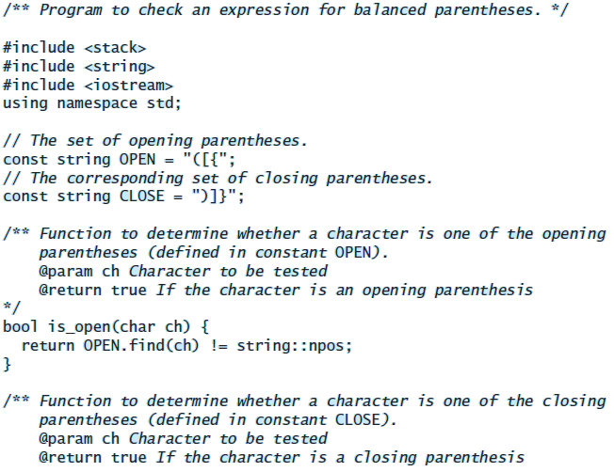
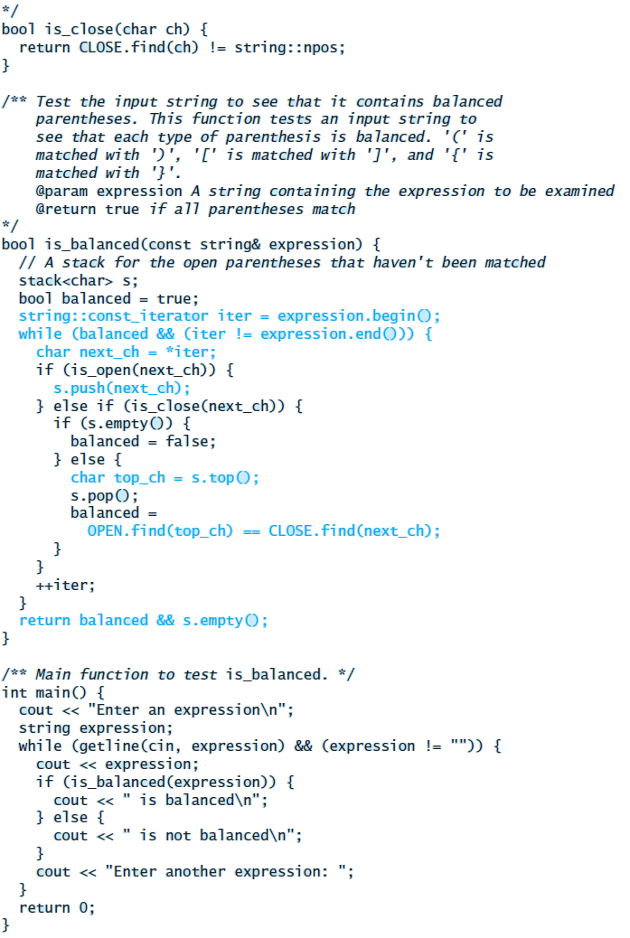
Implementation

Slide 38
Implementation
(please split the listing on the preceding slide at “bool is_balanced…” putting the second half here, and enlarging both halves)

Slide 39
Testing
Provide a variety of input expressions displaying the result true or false
Try several levels of nested parentheses
Try nested parentheses where corresponding parentheses are not of the same type
Try unbalanced parentheses
Try no parentheses at all!
PITFALL:
If you attempt to pop an empty stack your program will probably halt and report a run-time error
The nature of the error message will depend on the compiler and operating system
It is possible that no error is reported at all. You can guard against this error by testing for a nonempty stack before calling top or pop

Slide 40
Implementing a Stack
Section 5.3

Slide 41
Implementing a Stack
A stack is similar to a vector
The standard library defines the stack as a template class that takes any of the sequential containers (vector, list, or deque – described in Chapter 6) as a template parameter
We present two implementations in this section:
A standard template container
A special-purpose single-linked list

Slide 42
Implementing a Stack (cont.)

Slide 43
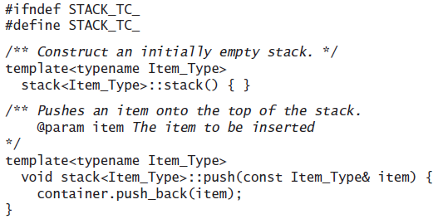
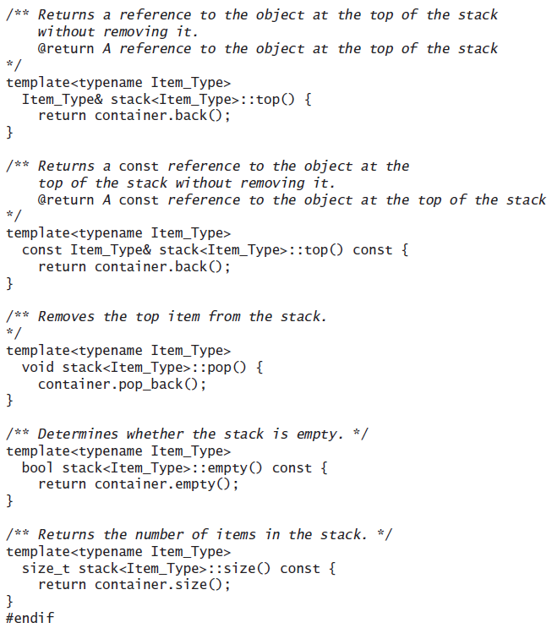
Implementing a Stack (cont.)

Slide 44
Implementing a Stack (cont.)
This implementation is similar to the implementation in the C++ standard library
All sequential containers provide the functions empty, size, back (equivalent to stack::top), push_back (equivalent to stack::push) and pop_back (equivalent to stack::pop), so we could use any of these containers

Slide 45
Adapter Classes and the Delegation Pattern
The stack class uses the delegation pattern discussed in Chapter 4 by making the functions in the underlying container class do its work for it
It is also said to be an adapter class because it adapts the functions available in another class to the interface its clients expect by giving different names to essentially the same operations
For example, if a vector is used as the container object, stack::push corresponds to vector::push_back, stack::top corresponds to vector::back, and so on

Slide 46
Revisiting the Definition File stack.h
To implement the stack using a vector object as a container, change the definition of the data member container in the private part of the class definition:
std::vector<Item_Type> container;
If you prefer to use a deque for a container, substitute deque<Item_Type> for vector<Item_Type> in the declaration of container

Slide 47
Revisiting the Definition File stack.h (cont.)
The member function implementations shown in the preceding listing should be included after the class definition but before the end of the namespace
Template member function implementations must be included with the class definitions
In the a prior listing, we used an include directive to insert the code for the member function definitions at the end of the file:
// Insert implementation of member functions here
#include Stack.tc
} // End namespace KW
#endif
The listing on the next slide shows an alternative which replaces each function declaration in file stack.h with its actual definition

Slide 48
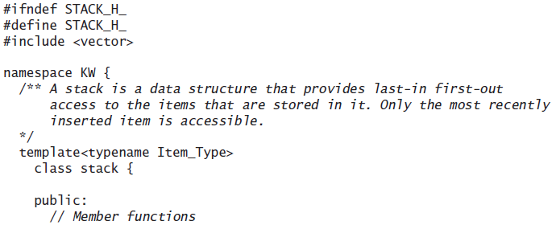
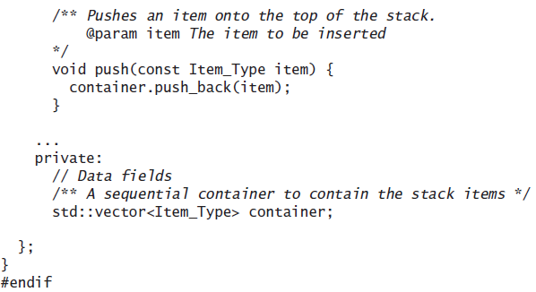
Revisiting the Definition File stack.h (cont.)

Slide 49
Implementing a Stack as a Linked Data Structure
We can also implement a stack using a linked list of nodes

Slide 50
Implementing a Stack as a Linked Data Structure (cont.)
File Linked_Stack.tc defines a stack class that contains a collection of Node objects
Recall that inner class Node has data fields data (type Item_Type) and next (type Node*)
To use this implementation we need to replace the statements at the end of file stack.h with the following:
private:
#include "Node.h"
Node* top_of_stack;
}; // End class stack
#include "Linked_Stack.tc"
} // End namespace KW
#endif

Slide 51
Implementing a Stack as a Linked Data Structure (cont.)
File Linked_Stack.tc defines a stack class that contains a collection of Node objects
Recall that inner class Node has data fields data (type Item_Type) and next (type Node*)
To use this implementation we need to replace the statements at the end of file stack.h with the following:
private:
#include "Node.h"
Node* top_of_stack;
}; // End class stack
#include "Linked_Stack.tc"
} // End namespace KW
#endif
Pointer variable top_of_stack points to the last element placed on the stack. Because it is easier to insert and remove from the head of a linked list, we set top_of_stack to point to the node at the head of the list

Slide 52
Implementing a Stack as a Linked Data Structure (cont.)
Function push inserts a node at the head of the list. The statement
top_of_stack = new Node(item, top_of_stack);
sets top_of_stack to point to the new node;
top_of_stack->next references the old top of
the stack
When the stack is empty, top_of_stack is NULL, so the attribute next for the first object pushed onto the stack (the item at the bottom) will be NULL

Slide 53
Implementing a Stack as a Linked Data Structure (cont.)
Function top returns top_of_stack->data
Function empty tests for a value of top_of_stack equal to NULL
Function pop resets top_of_stack to the value stored in the next field of the list head and then deletes the old top of the stack (pointed to by old_top)

Slide 54
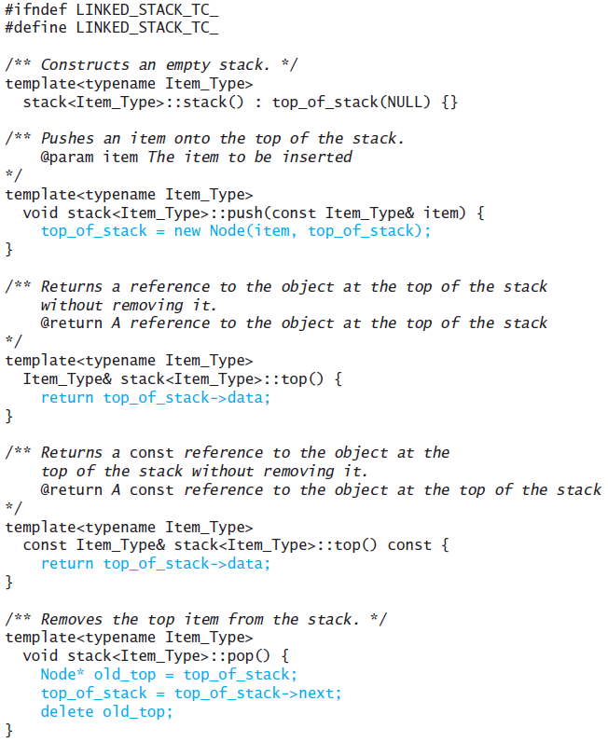
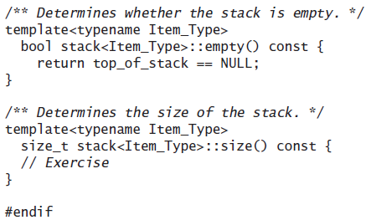
Implementing a Stack as a Linked Data Structure (cont.)

Slide 55
Comparison of Stack Implementations
The implementation shown in the preceding listing is similar to the implementation provided by the C++ standard library
By delegating the operations to an underlying sequential container, we avoid having to implement these operations ourselves
By using the functions push_back, pop_back, and back, we are assured of constant time (O(1)) performance, since the C++ standard requires that implementations of the sequential containers provide these operations in (amortized) constant time

Slide 56
Comparison of Stack Implementations (cont.)
Use of the standard containers has a space penalty
To achieve the amortized constant performance for push_back, and so forth, the vector and deque allocate additional space
As we saw in Section 4.3, the vector will allocate an array twice the current size whenever it needs to allocate additional space
As we will see in Chapter 6, the deque also allocates additional space
The standard list class is a double-linked list; thus each Node contains pointers to both a next and a previous entry
This flexibility is not needed for the stack

Slide 57
Comparison of Stack Implementations (cont.)
Using your own linked data structure has the advantage of using exactly as much storage as is needed for the stack
However, you need to allocate storage for the links
Because all insertions and deletions are at one end, the flexibility provided by a linked data structure is not utilized
All stack operations using a linked data structure are O(1)

Slide 58
Additional Stack Applications
Section 5.4

Slide 59
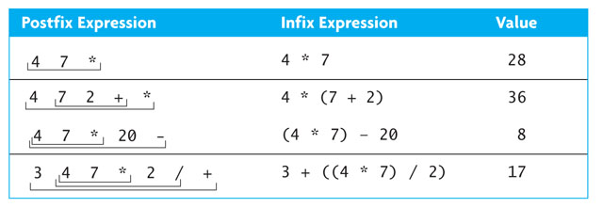
Additional Stack Applications
Postfix and infix notation
Expressions normally are written in infix form, but
it easier for a computer to evaluate an expression in postfix form since there is no need to group sub-expressions in parentheses or worry about operator precedence

Slide 60
Evaluating Postfix Expressions
Write a class that evaluates a postfix expression containing digit characters and operator characters +, -, *, and /
Use the space character as a delimiter between tokens

Slide 61
Evaluating Postfix Expressions – Analysis and Design
Save operands on a stack until their associated operator is scanned
Then pop the operands, compute the result, and push it back onto the stack
Assume binary operators and disallow negative operands

Slide 62
Evaluating Postfix Expressions (cont.)
4
4
7
*
20
-
4
1. Empty the operand stack
2. while there are more tokens
3. get the next token
4. if the first character of the token is a digit
5. push the token on the stack
6. else if the token is an operator
7. pop the right operand off the stack
8. pop the left operand off the stack
9. evaluate the operation
10. push the result onto the stack
11. pop the stack and return the result

Slide 63
Evaluating Postfix Expressions (cont.)
4
4
7
7
*
20
-
4
7
4
1. Empty the operand stack
2. while there are more tokens
3. get the next token
4. if the first character of the token is a digit
5. push the token on the stack
6. else if the token is an operator
7. pop the right operand off the stack
8. pop the left operand off the stack
9. evaluate the operation
10. push the result onto the stack
11. pop the stack and return the result

Slide 64
Evaluating Postfix Expressions (cont.)
4 * 7
4
4
7
7
*
20
-
7
4
1. Empty the operand stack
2. while there are more tokens
3. get the next token
4. if the first character of the token is a digit
5. push the token on the stack
6. else if the token is an operator
7. pop the right operand off the stack
8. pop the left operand off the stack
9. evaluate the operation
10. push the result onto the stack
11. pop the stack and return the result

Slide 65
Evaluating Postfix Expressions (cont.)
28
4
4
7
7
*
20
-
28
1. Empty the operand stack
2. while there are more tokens
3. get the next token
4. if the first character of the token is a digit
5. push the token on the stack
6. else if the token is an operator
7. pop the right operand off the stack
8. pop the left operand off the stack
9. evaluate the operation
10. push the result onto the stack
11. pop the stack and return the result

Slide 66
Evaluating Postfix Expressions (cont.)
4
4
7
7
*
20
20
-
28
20
28
1. Empty the operand stack
2. while there are more tokens
3. get the next token
4. if the first character of the token is a digit
5. push the token on the stack
6. else if the token is an operator
7. pop the right operand off the stack
8. pop the left operand off the stack
9. evaluate the operation
10. push the result onto the stack
11. pop the stack and return the result

Slide 67
Evaluating Postfix Expressions (cont.)
28 - 20
4
4
7
7
*
20
-
20
28
1. Empty the operand stack
2. while there are more tokens
3. get the next token
4. if the first character of the token is a digit
5. push the token on the stack
6. else if the token is an operator
7. pop the right operand off the stack
8. pop the left operand off the stack
9. evaluate the operation
10. push the result onto the stack
11. pop the stack and return the result

Slide 68
Evaluating Postfix Expressions (cont.)
8
4
4
7
7
*
20
-
8
1. Empty the operand stack
2. while there are more tokens
3. get the next token
4. if the first character of the token is a digit
5. push the token on the stack
6. else if the token is an operator
7. pop the right operand off the stack
8. pop the left operand off the stack
9. evaluate the operation
10. push the result onto the stack
11. pop the stack and return the result

Slide 69
Evaluating Postfix Expressions (cont.)
4
4
7
7
*
20
-
8
1. Empty the operand stack
2. while there are more tokens
3. get the next token
4. if the first character of the token is a digit
5. push the token on the stack
6. else if the token is an operator
7. pop the right operand off the stack
8. pop the left operand off the stack
9. evaluate the operation
10. push the result onto the stack
11. pop the stack and return the result

Slide 70
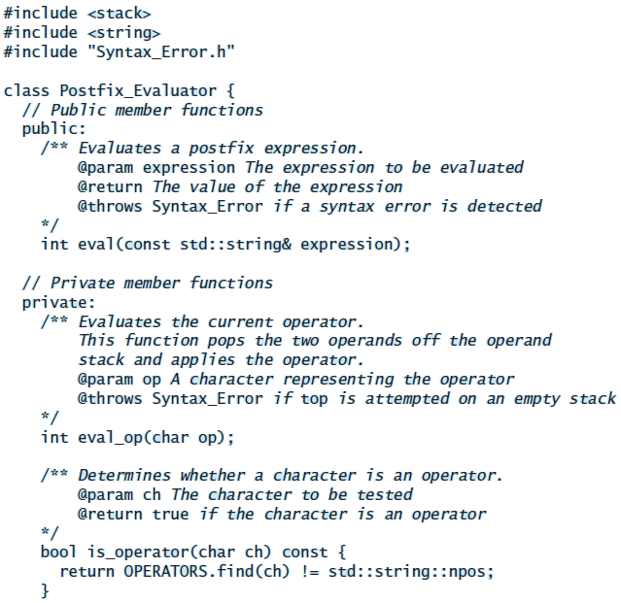
Evaluating Postfix Expressions (cont.)

Slide 71
Evaluating Postfix Expressions (cont.)

Slide 72
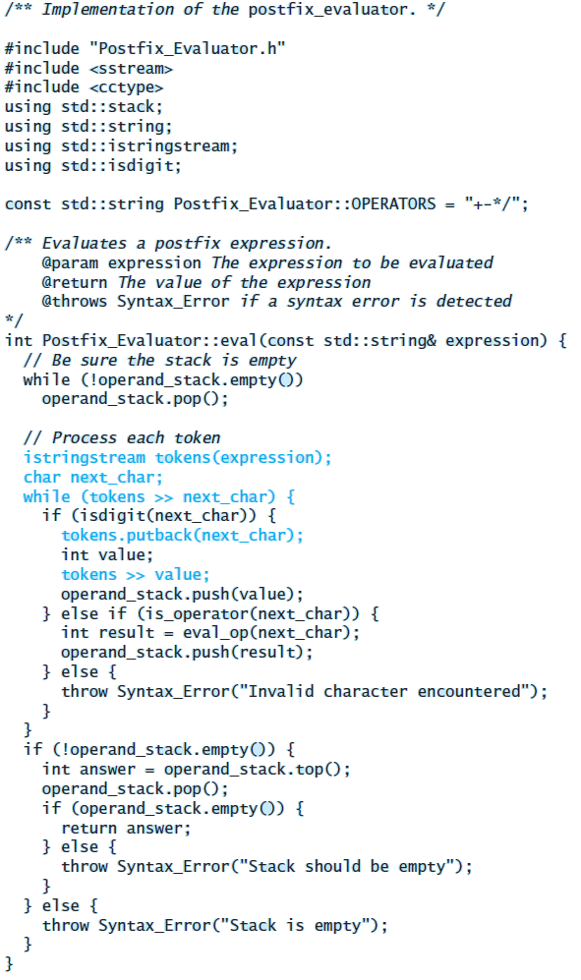
Evaluating Postfix Expressions (cont.)

Slide 73
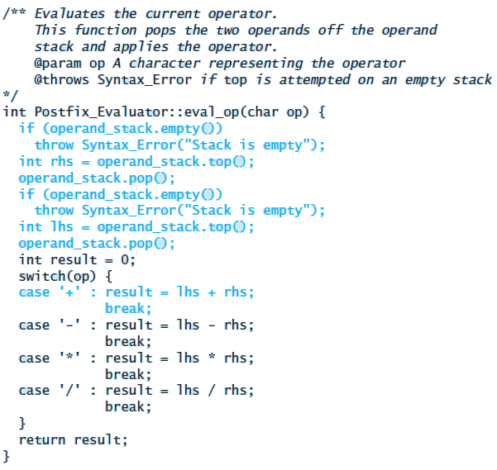
Evaluating Postfix Expressions (cont.)

Slide 74
Evaluating Postfix Expressions (cont.)
Testing: write a driver which
creates a Postfix_Evaluator object
reads one or more expressions and reports the result
catches the Syntax_Error exception.
exercises each path by using each operator
exercises each path through eval by trying different orderings and multiple occurrences of operators
tests for syntax errors:
an operator without any operands
a single operand
an extra operand
an extra operator
a variable name
the empty string

Slide 75
Converting from Infix to Postfix
Convert infix expressions to postfix expressions
Assume:
expressions consists of only spaces, operands, and operators
space is a delimiter character
all operands that are identifiers begin with a letter
all operands that are numbers begin with a digit

Slide 76
Converting from Infix to Postfix (cont.)
Example: convert
w – 5.1 / sum * 2
to its postfix form:
w 5.1 sum / 2 * -

Slide 77
Converting from Infix to Postfix (cont.)
For expressions without parentheses, there are two criteria that determine the order of operator evaluation:
Operators are evaluated according to their precedence or rank; higher-precedence operators are evaluated before lower-precedence operators. For example, *, /, and % (the multiplicative operators) are evaluated before +, –
Operators with the same precedence are evaluated in left-to-right order (left associative rule)

Slide 78
Converting from Infix to Postfix (cont.)
By temporarily storing the operators on a stack, we can pop them when needed and insert them in the postfix string in an order that indicates when they should be evaluated
For example, if we have the first two operators from the string "w - 5.1 / sum * 2" stored on a stack as follows:
The operator “/” (scanned second) must come off the stack and be placed in the postfix string before the operator - (scanned first)
If we have the stack as just shown and the next operator is “*”, we need to pop the “/” off the stack and insert it in the postfix string before “*”, because the multiplicative operator scanned earlier (/) should be evaluated before the multiplicative operator (*) scanned later (the left-associative rule)
/
-

Slide 79
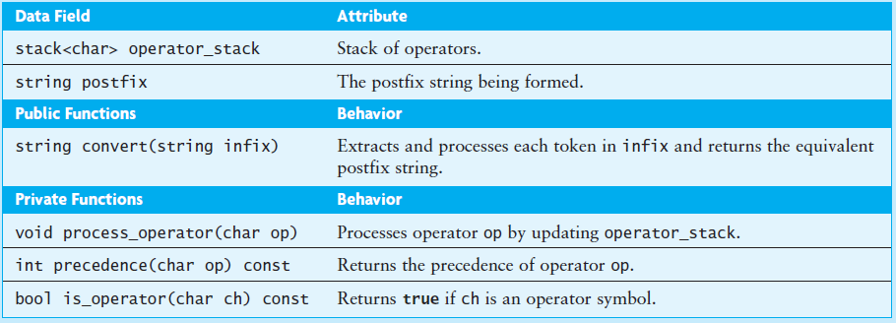
Converting from Infix to Postfix (cont.)

Slide 80
Converting from Infix to Postfix (cont.)

Slide 81
Converting from Infix to Postfix (cont.)

Slide 82
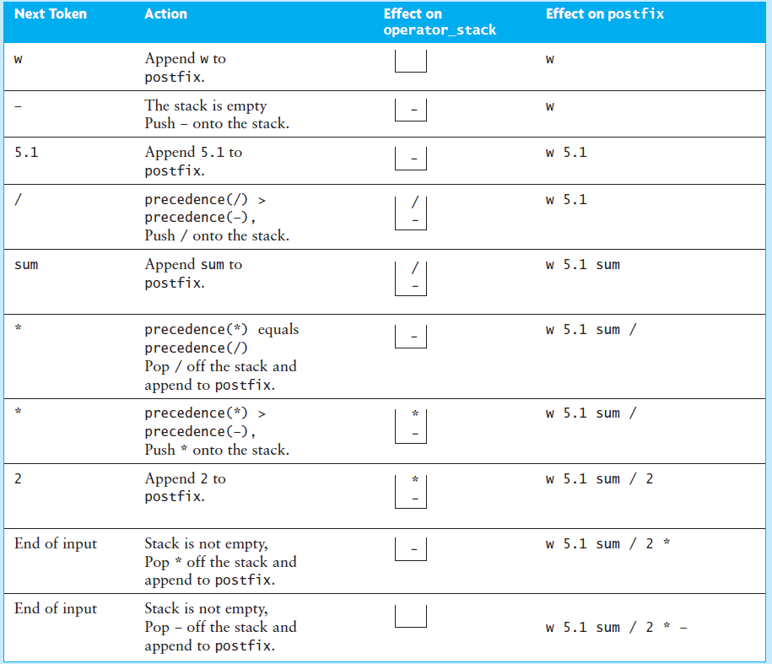
Converting from Infix to Postfix (cont.)

Slide 83
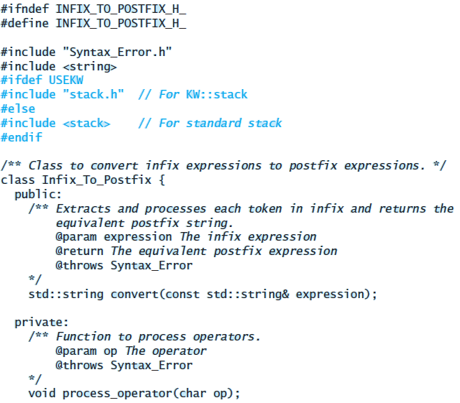
Converting from Infix to Postfix (cont.)

Slide 84
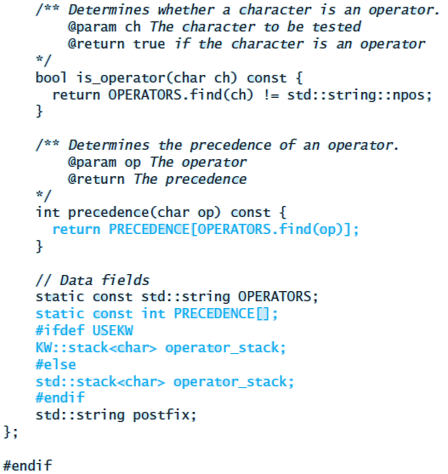
Converting from Infix to Postfix (cont.)

Slide 85
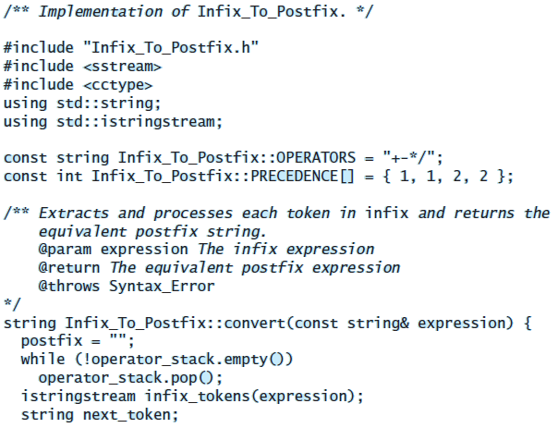
Converting from Infix to Postfix (cont.)

Slide 86
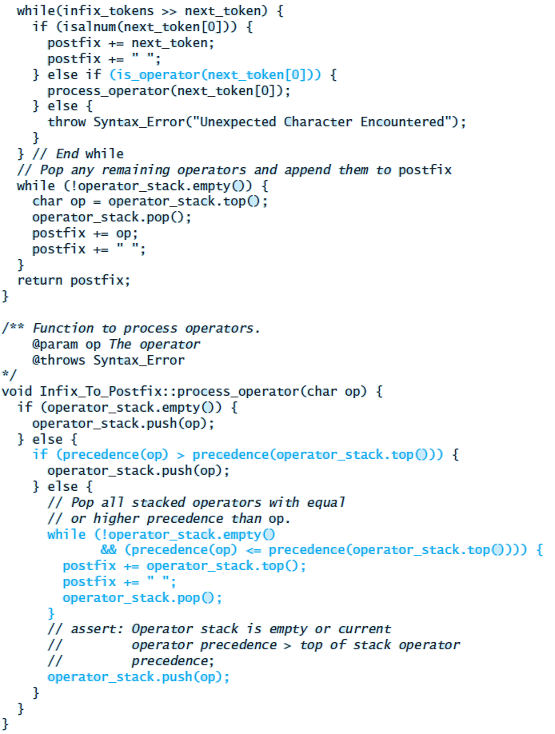
Converting from Infix to Postfix (cont.)

Slide 87
Converting from Infix to Postfix (cont.)
Testing
Use enough test expressions to satisfy yourself that the conversions are correct for properly formed input expressions
Try:
Different orderings
Multiple occurrences of the operators
Infix expressions where all operators have the same precedence
Catch the exception SyntaxError

Slide 88
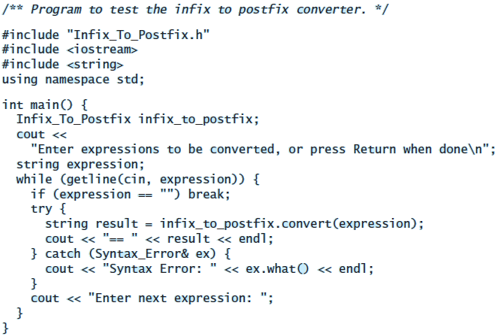
Converting from Infix to Postfix (cont.)
Testing

Slide 89
Converting Expressions with Parentheses
The ability to convert expressions with parentheses is an important (and necessary) enhancement
Parentheses are used to separate an expression into subexpressions
Modify process_operator to push each opening parenthesis onto the stack as soon as it is scanned
if (operator_stack.empty() || (op == '(')) {
if (op == ')')
throw Syntax_Error("Unmatched close parenthesis");
operator_stack.push(op);

Slide 90
Converting Expressions with Parentheses (cont.)
When a closing parenthesis is scanned, pop all operators up to and including the matching opening parenthesis, inserting all operators popped (except for the opening parenthesis) in the postfix string
This will happen automatically in the following while statement if the precedence of the closing parenthesis is lower than that of any other operator except for the opening parenthesis
while (!operator_stack.empty()
&& (operator_stack.top() != '(')
&& (precedence(op) <= precedence(operator_stack.top()))){
postfix += operator_stack.top();
postfix += " ";
operator_stack.pop();
}

Slide 91
Converting Expressions with Parentheses (cont.)
A closing parenthesis is considered processed when the corresponding opening parenthesis is popped from the stack, and the closing parenthesis is not placed on the stack
The following if statement executes after the while loop exit:
if (op == ')') {
if (!operator_stack.empty()
&& (operator_stack.top() == '(')) {
operator_stack.pop();
} else {
throw Syntax_Error("Unmatched close parentheses");
}
}

Slide 92
Converting Expressions with Parentheses (cont.)

Slide 93
Converting Expressions with Parentheses (cont.)
Testing:
Use the classes developed for the prior case studies to evaluate infix expressions with integer operands and nested parentheses
Our driver program will need to create instances of both classes and apply function convert to the Infix_To_Postfix_Parens object
The argument for convert will be the infix expression; the result will be its postfix form
Next, the driver will apply function eval of the Postfix_Evaluator object
The argument for eval will be the postfix expression returned by convert
Make sure there is a space before and after each parenthesis

